Slide 1



AMT Presentation
Speaker: Jun-Teng Yang (楊駿騰)
Advisor: Prof. Scott C.-H Huang (黃之浩)
Date: 03/27/2020

Slide 2
Outline
Self-introduction
Project Experience
AI for Deception Detection in Videos.
Image Segmentation using Gaussian Mixture Model (GMM) and Expectation-Maximization (EM) Algorithm
Algorithm Implementation for Adaptive Channel Equalization
Navigation APP with combining Near-field communication (NFC) and Augmented Reality (AR)

Slide 3
Self-introduction

Slide 4
About me
National Tsing Hua University
MS Communications Engineering (2016 – 2017) (Direct Pursuit of PhD Degree)
PhD candidate Communications Engineering (2017 – present) GPA: 4.11
National Kaohsiung University of Science and Technology
BS Computer and Communications Engineering (2012 – 2016) Avg. 94.64 (No. 1)
Research Interest
Video/image Processing
Machine Learning, Deep Learning
Computer Vision
Convex Optimization

Slide 5
About me
Programming Language
Python (Keras, TensorFlow, PyTorch, OpenCV)
MATLAB
C, C++
C# (Web, Mobile APP), Java (Mobile APP)
GitHub
https://github.com/ryanyangjt

Slide 6
Project Experience: AI for Deception Detection in Videos

Slide 7
What Deception Detection is?
Verbal Cues voice pitch, voice energy, statement meaning, etc.
Non-Verbal Cues facial expressions, body movement, physiological characteristics, etc.
Verbal cues
Truthful
Deception Detection
Non-verbal cues
Deceptive

Slide 8
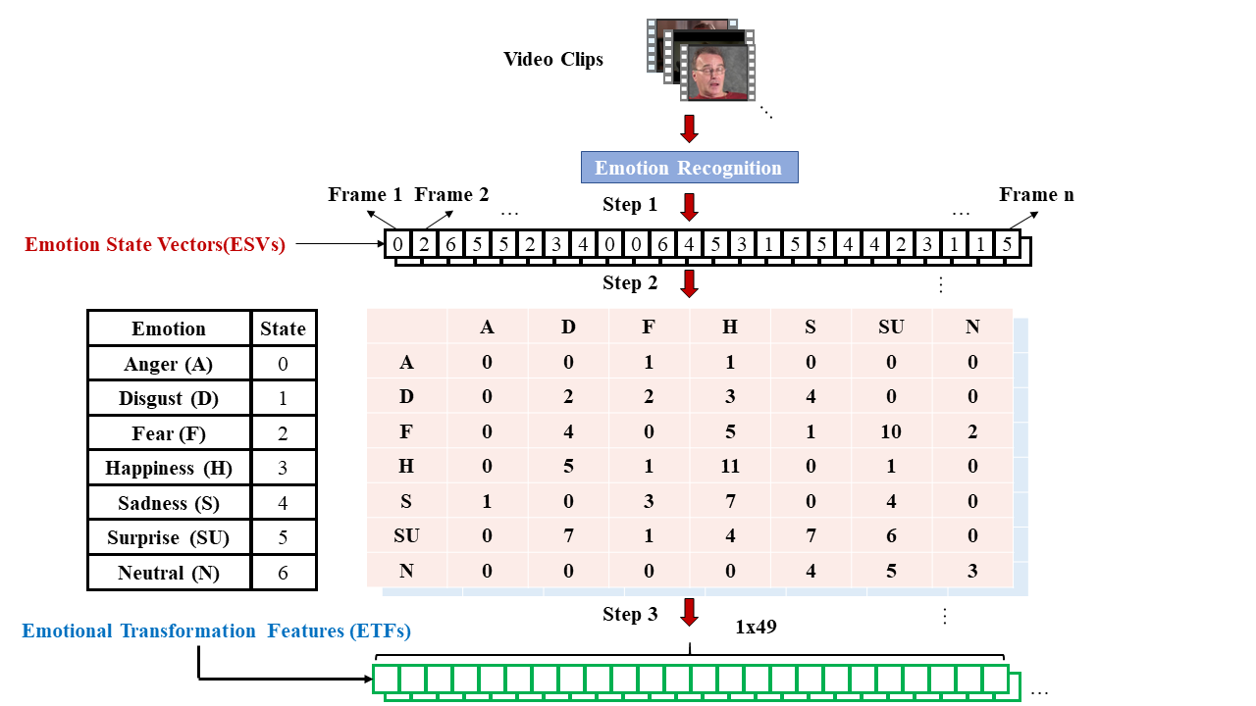
Novel Feature: Emotion Transformation Feature

Slide 9
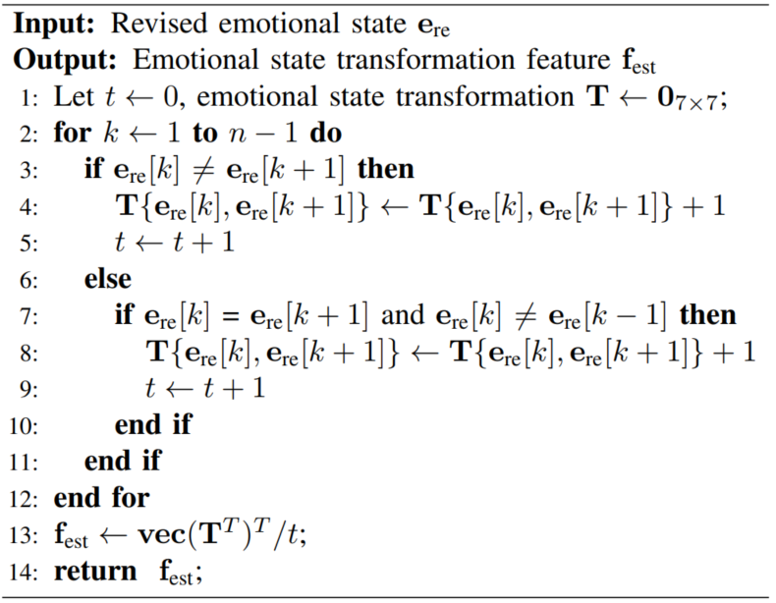
Algorithm for ETFs Construction

Slide 10
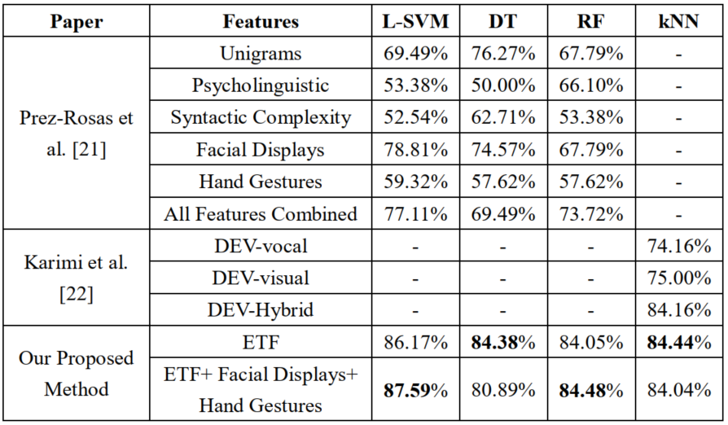
Performance

Slide 11
Project Experience: Image Segmentation using Gaussian Mixture Model (GMM) and Expectation-Maximization (EM) Algorithm

Slide 12
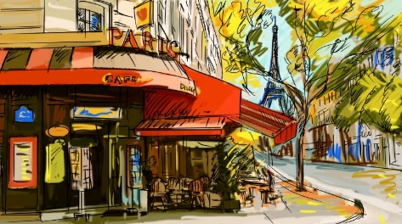
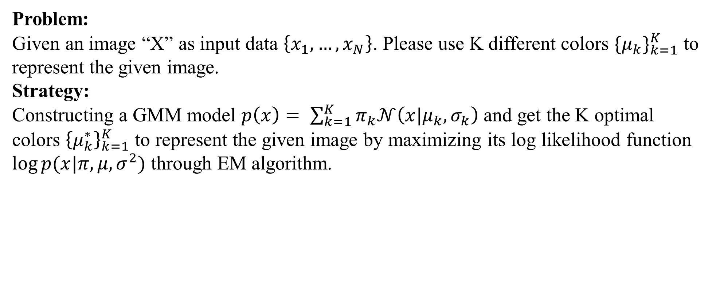
Problem Statement for Image Segmentation
Problem: Given an image “X” as input data $\left\{x_{1},…,x_{N}\right\}$. Please use K different colors ${{\{μ}_{k}\}}_{k=1}^{K}$ to represent the given image. Strategy: Constructing a GMM model $p\left(x\right)= \sum_{k=1}^{K}{π_{k}𝒩\left(x|μ_{k}, σ_{k}\right)}$ and get the K optimal colors ${\left\{μ_{k}^{∗}\right\}}_{k=1}^{K}$ to represent the given image by maximizing its log likelihood function $\log{p(x|π,μ,σ^{2})}$ through EM algorithm.

Slide 13
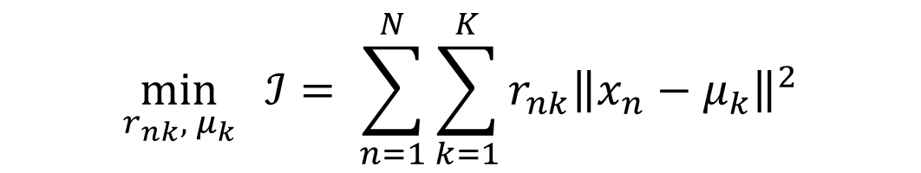
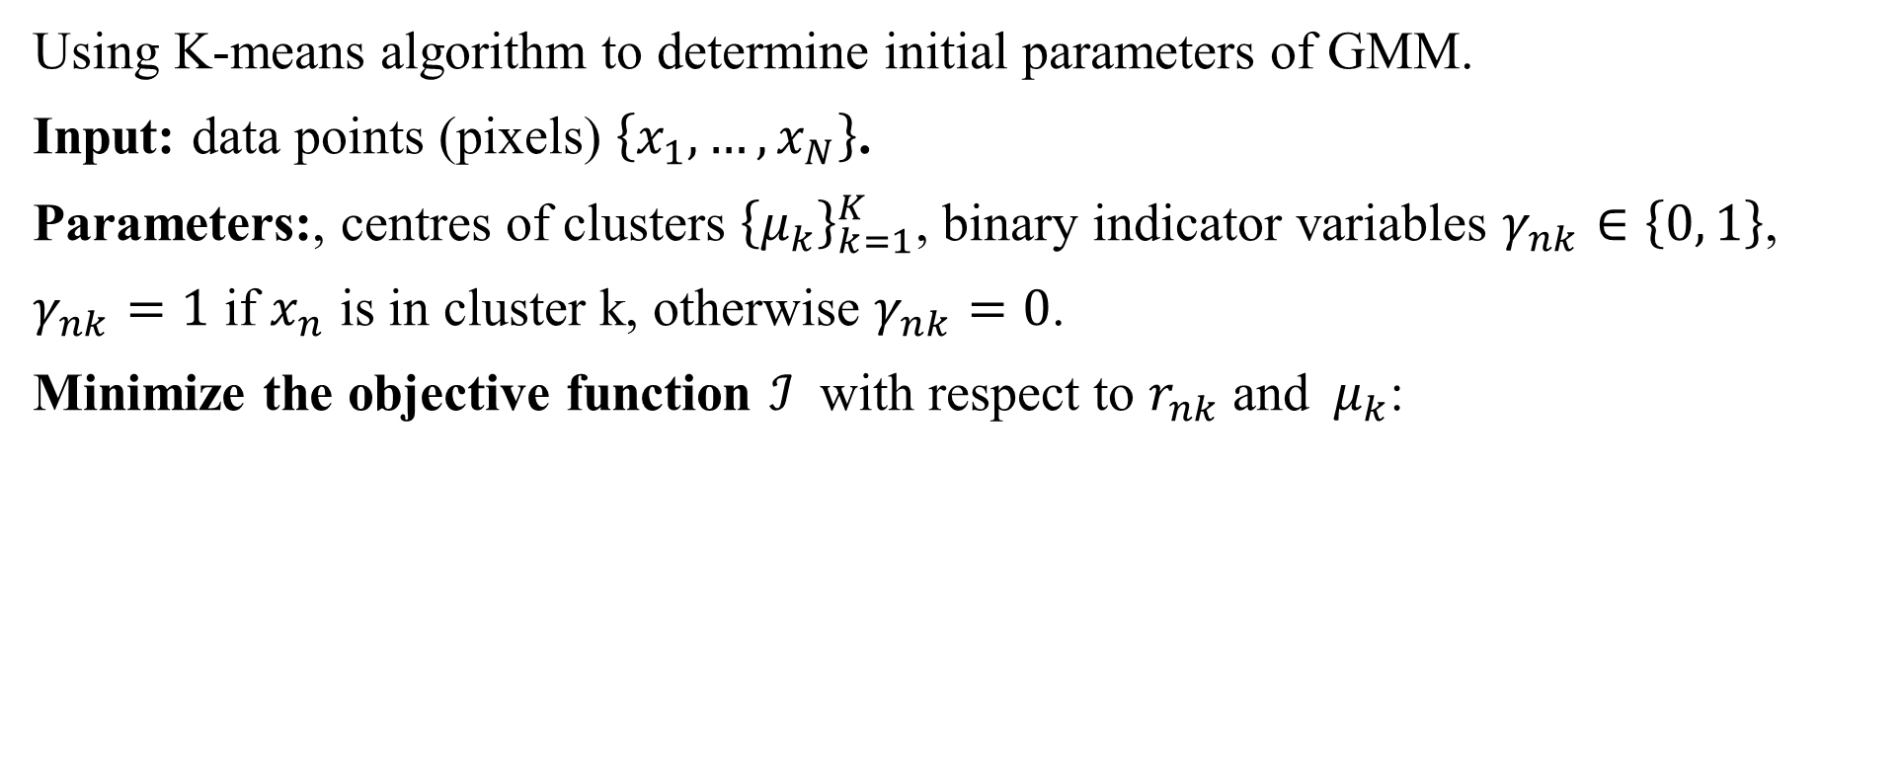
Step 1: K-means Algorithm
Using K-means algorithm to determine initial parameters of GMM.
Input: data points (pixels) $\left\{x_{1},…,x_{N}\right\}$.
Parameters:, centres of clusters ${\left\{μ_{k}\right\}}_{k=1}^{K}$, binary indicator variables $γ_{nk}∈\left\{0, 1\right\}$,
$γ_{nk}=1$ if $x_{n}$ is in cluster k, otherwise $γ_{nk}=0$.
Minimize the objective function $ℐ$ with respect to $r_{nk}$and$μ_{k}$:
$$\min_{r_{nk}, μ_{k}}{ℐ= \sum_{n=1}^{N}{\sum_{k=1}^{K}{r_{nk}{\left\|x_{n}−μ_{k}\right\|}^{2}}}}$$

Slide 14
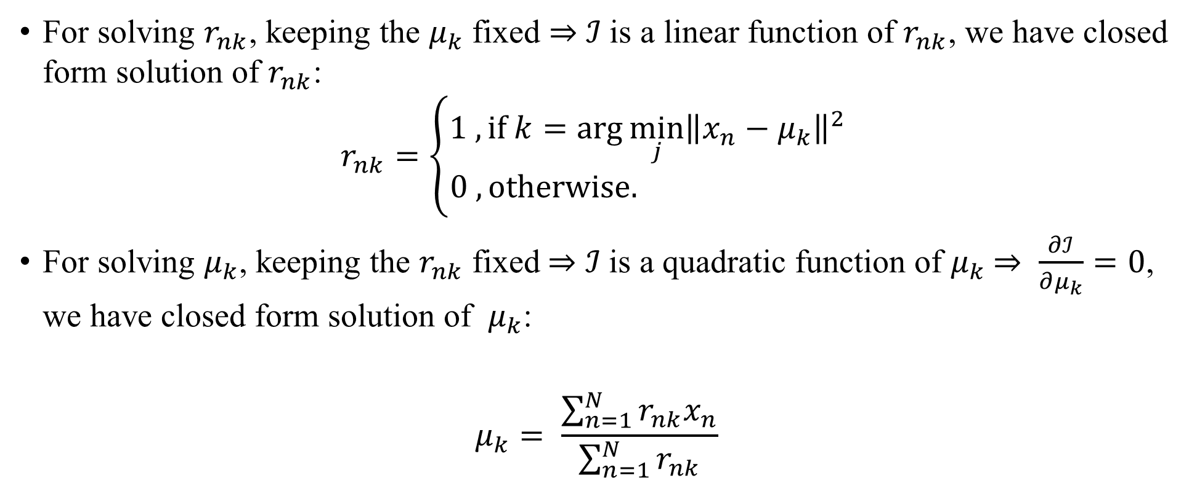
Step 1: K-means Algorithm (Cont.)
For solving $r_{nk}$, keeping the $μ_{k}$ fixed $⇒$ $ℐ$is a linear function of $r_{nk}$, we have closed form solution of $r_{nk}$:
$$r_{nk}=\left\{\begin{aligned}1 , if k=\arg{\min_{j}{{\left\|x_{n}−μ_{k}\right\|}^{2}}} \\ 0 , otherwise. \end{aligned}\right.$$
For solving $μ_{k}$, keeping the $r_{nk}$ fixed$⇒$ $ℐ$is a quadratic function of $μ_{k}$ $⇒ \frac{∂ℐ}{∂μ_{k}}=0$, we have closed form solution of $μ_{k}$:
$$μ_{k}= \frac{\sum_{n=1}^{N}{r_{nk}x_{n}}}{\sum_{n=1}^{N}{r_{nk}}}$$

Slide 15
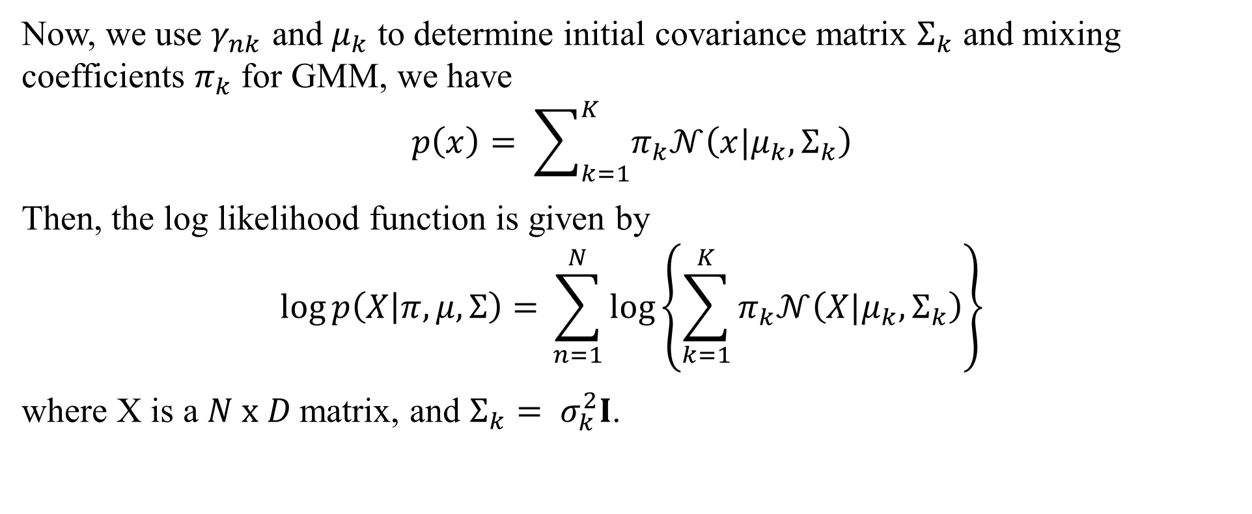
Step 2: GMM Construction
Now, we use $γ_{nk}$ and $μ_{k}$ to determine initial covariance matrix $Σ_{k}$ and mixing coefficients $π_{k}$ for GMM, we have
$$p\left(x\right)= \sum_{k=1}^{K}{π_{k}𝒩\left(x|μ_{k},Σ_{k}\right)}$$
Then, the log likelihood function is given by
$$\log{p\left(X | π,μ,Σ\right)=} \sum_{n=1}^{N}{\log\left\{\sum_{k=1}^{K}{π_{k}𝒩\left(X|μ_{k}, Σ_{k}\right)}\right\}}$$
where X is a $N x D$matrix, and $Σ_{k}= σ_{k}^{2}I$.

Slide 16
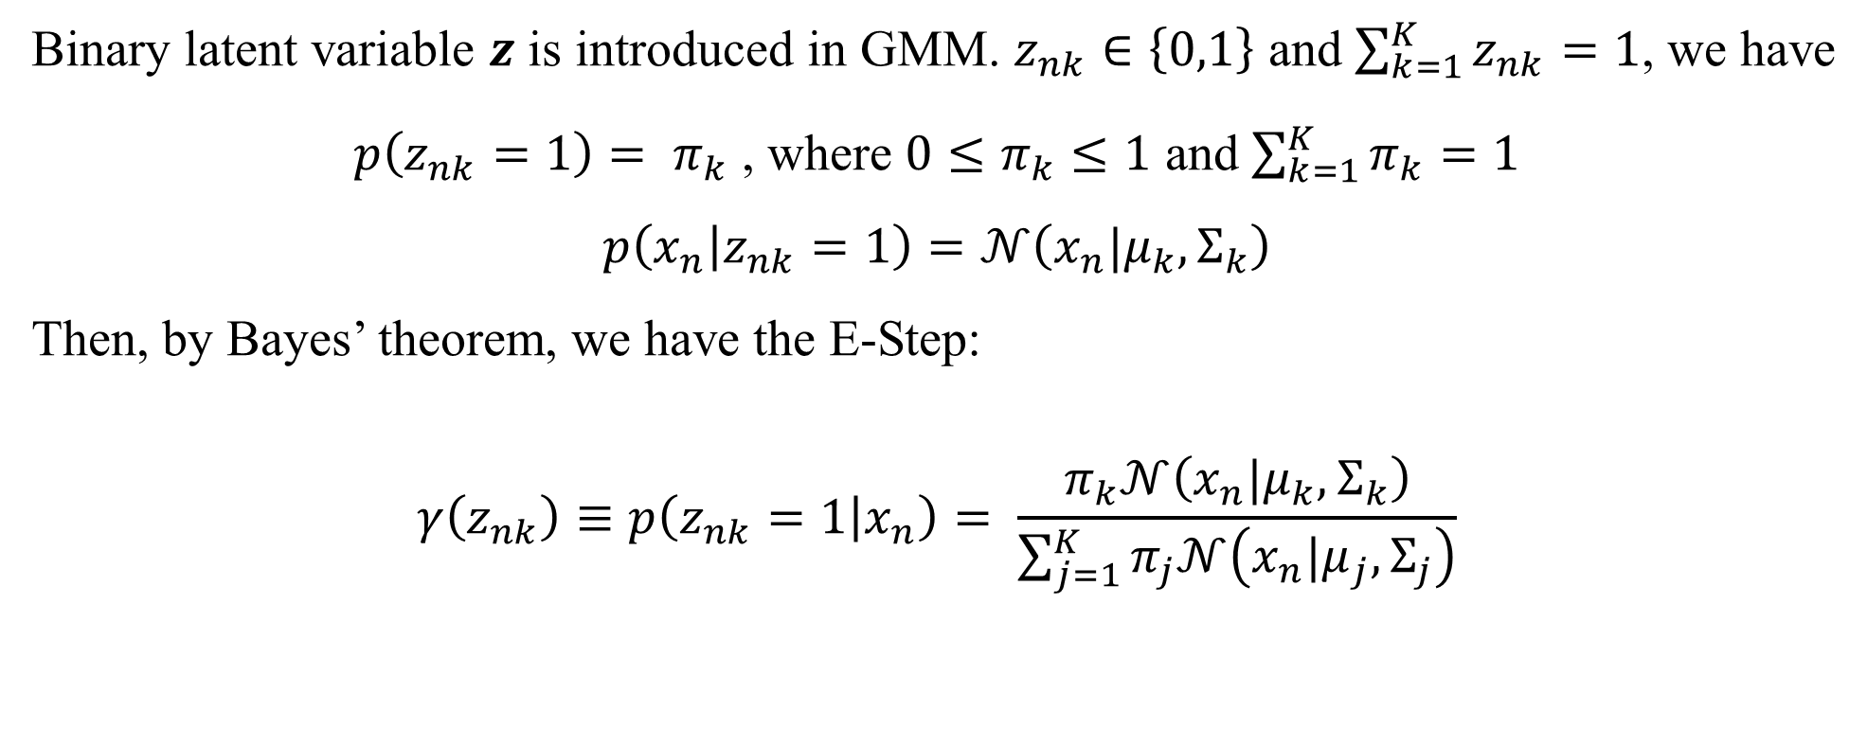
Step 3: Expectation-Step
Binary latent variable $z$ is introduced in GMM. $z_{nk}∈\left\{0,1\right\}$ and $\sum_{k=1}^{K}{z_{nk}=1}$, we have
$p\left(z_{nk}=1\right)= π_{k}$ , where $0≤π_{k}≤1$ and $\sum_{k=1}^{K}{π_{k}}=1$
$$p\left(x_{n} | z_{nk}=1\right)=𝒩\left(x_{n}|μ_{k}, Σ_{k}\right)$$
Then, by Bayes’ theorem, we have the E-Step:
$$γ\left(z_{nk}\right)≡p\left(z_{nk}=1 | x_{n}\right)= \frac{π_{k}𝒩\left(x_{n}|μ_{k}, Σ_{k}\right)}{\sum_{j=1}^{K}{π_{j}𝒩\left(x_{n}|μ_{j}, Σ_{j}\right)}}$$

Slide 17
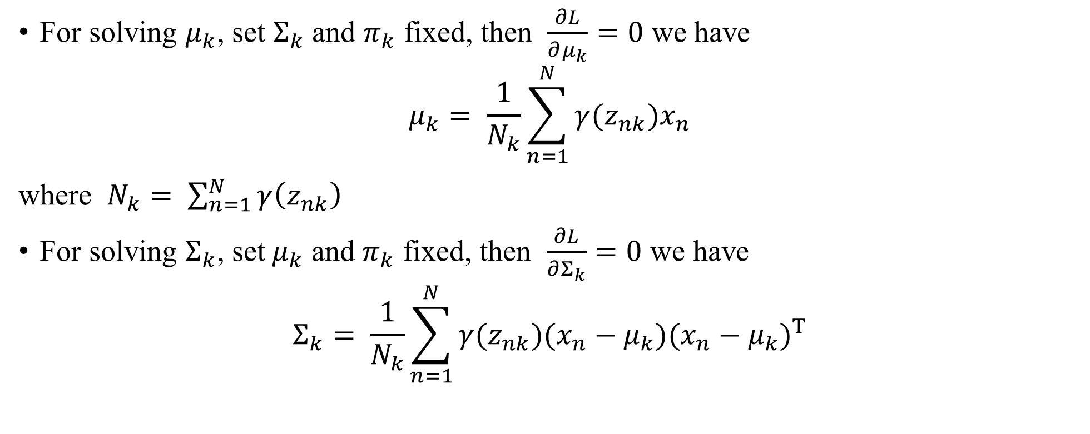
Step 3: Maximize the Log Likelihood Function
For solving $μ_{k}$, set $Σ_{k}$ and $π_{k}$ fixed, then $\frac{∂L}{∂μ_{k}}=0$ we have
$$μ_{k}= \frac{1}{N_{k}}\sum_{n=1}^{N}{γ(z_{nk})x_{n}}$$
where $N_{k}= \sum_{n=1}^{N}{γ\left(z_{nk}\right)}$
For solving $Σ_{k}$, set${ μ}_{k}$ and $π_{k}$ fixed, then $\frac{∂L}{∂Σ_{k}}=0$ we have
$$Σ_{k}= \frac{1}{N_{k}}\sum_{n=1}^{N}{γ(z_{nk})(x_{n}−μ_{k}){(x_{n}−μ_{k})}^{T}}$$

Slide 18

Step 3: Maximize the Log Likelihood Function (Cont.)
For solving${ π}_{k}$, set $Σ_{k}$ and${ μ}_{k}$fixed, and mixing coefficients has sum to one constraint
$⇒$ we have Lagrange multiplier
$$ℒ=\log{p\left(X | π,μ,Σ\right)+ λ(\sum_{k=1}^{K}{{ π}_{k}}−1)}$$
$⇒$ $\frac{∂ℒ}{∂{ π}_{k}}=0$ we have
$${ π}_{k }= \frac{N_{k}}{N}$$

Slide 19
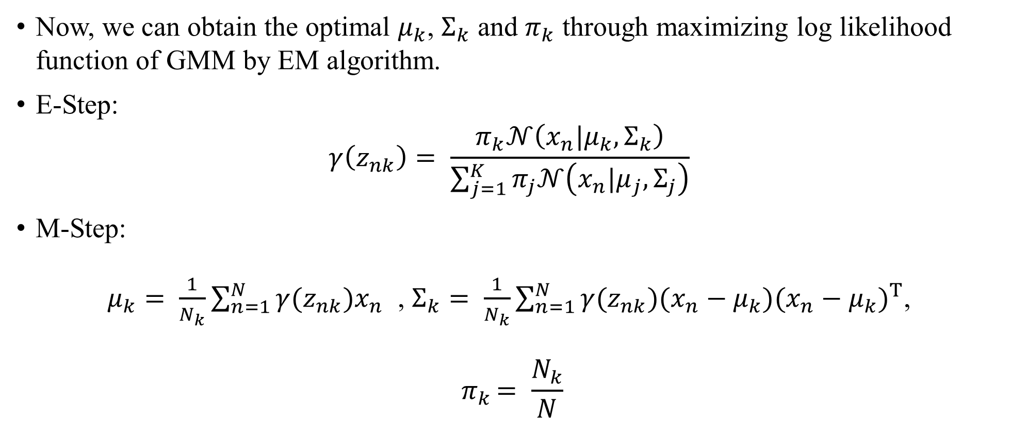
Step 3: EM Algorithm
Now, we can obtain the optimal $μ_{k}$, $Σ_{k}$ and $π_{k}$ through maximizing log likelihood function of GMM by EM algorithm.
E-Step:
$$γ\left(z_{nk}\right)= \frac{π_{k}𝒩\left(x_{n}|μ_{k}, Σ_{k}\right)}{\sum_{j=1}^{K}{π_{j}𝒩\left(x_{n}|μ_{j}, Σ_{j}\right)}}$$
M-Step:
$μ_{k}= \frac{1}{N_{k}}\sum_{n=1}^{N}{γ(z_{nk})x_{n}}$ , $Σ_{k}= \frac{1}{N_{k}}\sum_{n=1}^{N}{γ(z_{nk})(x_{n}−μ_{k}){(x_{n}−μ_{k})}^{T}}$,
$${ π}_{k }= \frac{N_{k}}{N}$$

Slide 20

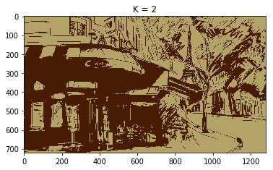
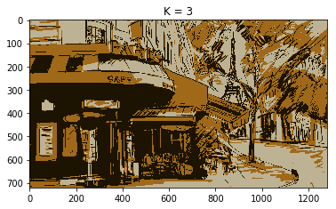
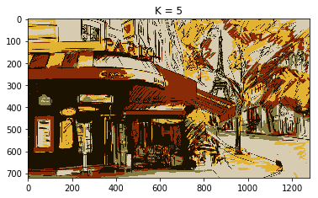
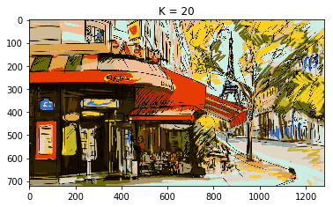
Results
Original

Slide 21
Project Experience: Algorithm Implementation for Adaptive Channel Equalization

Slide 22
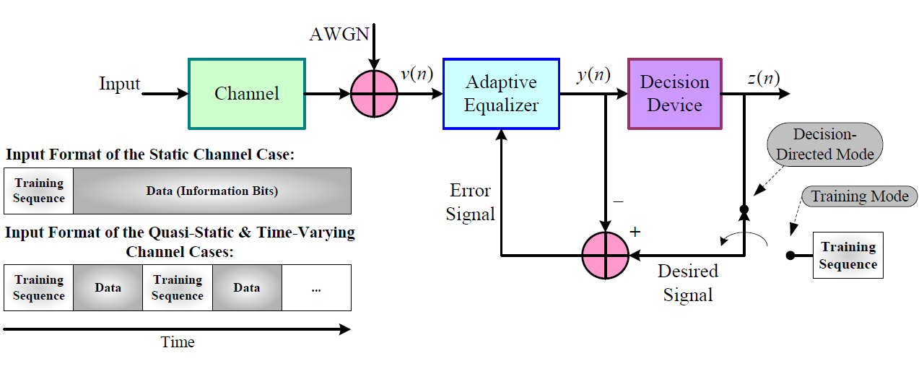
Adaptive Channel Equalization (ACE)
Problem: Most of the digital transmission of information is accompanied with a phenomenon known as inter symbol interference (ISI) and AWGN noise. Adaptive channel equalization method is needed to eliminate the influence from them.

Slide 23
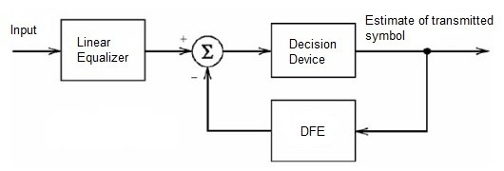
Algorithm Implementation for ACE
Strategy: I implemented the Decision Feedback Equalizer (DFE) framework and applied the Recursive Least Squares (RLS) algorithm to learn the channel characteristic (weights).
The DFE framework can effectively calculate the post-cursor ISI and subtract it.
The RLS algorithm can be expected to converge more quickly because the use of an aggressive, adaptive step size.

Slide 24
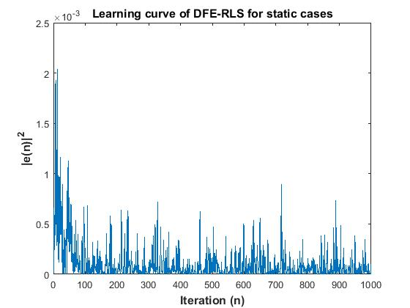
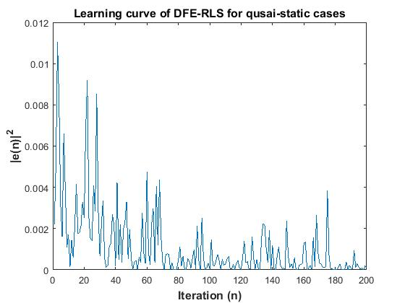
Results

Slide 25
Project Experience: Navigation APP with Near-field communication (NFC) and Augmented Reality (AR)

Slide 26

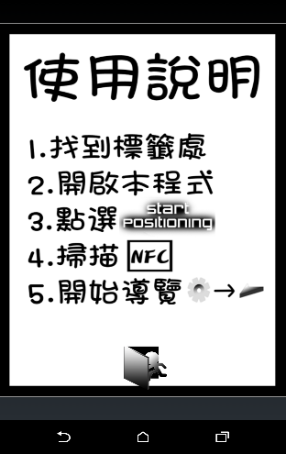
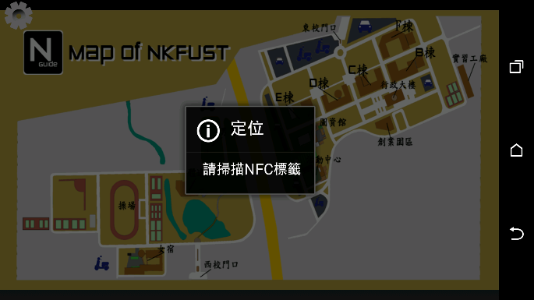
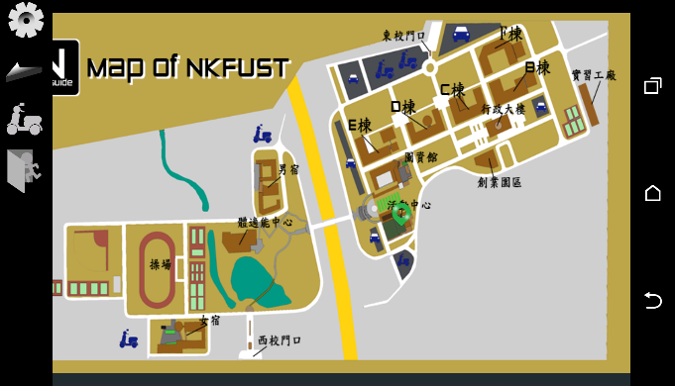
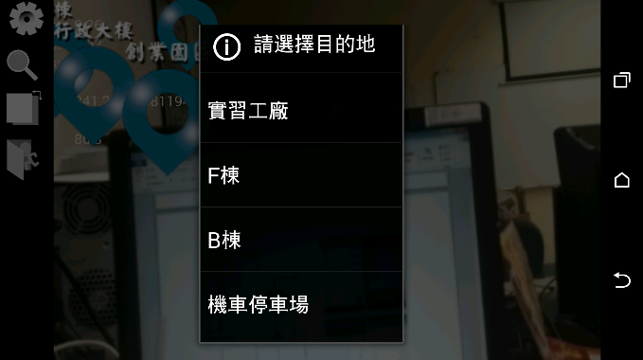
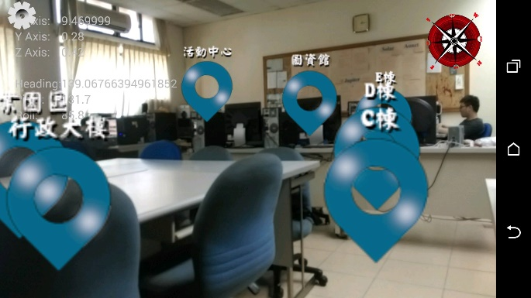
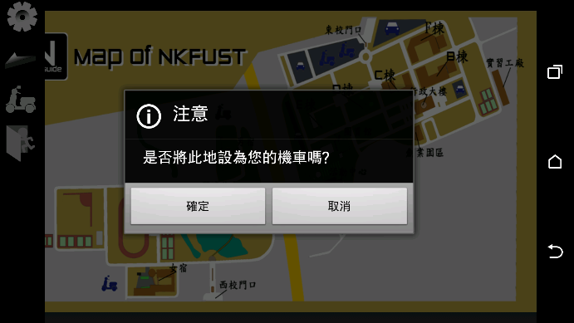
Navigation APP with NFC and AR
Start
Scan NFC Tag to check location
Yes
Is it the destination?
No
Open AR mode and select your destination
Start Navigation
End

Slide 27
Thank you for your attention!

